Slide 1
Machine architecture
Programming Language Design and Implementation (4th Edition)
by T. Pratt and M. Zelkowitz
Prentice Hall, 2001
Chapter 2

Slide 2
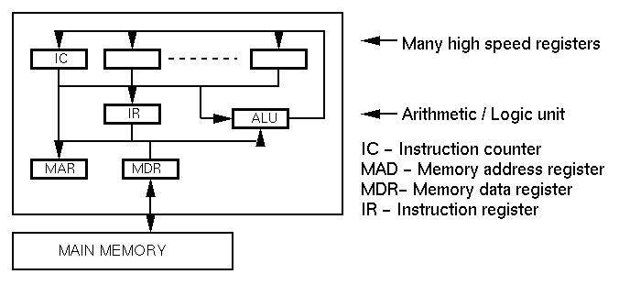
Typical machine design
Two cycles:
Fetch cycle - get instruction
Execute cycle - do operation

Slide 3
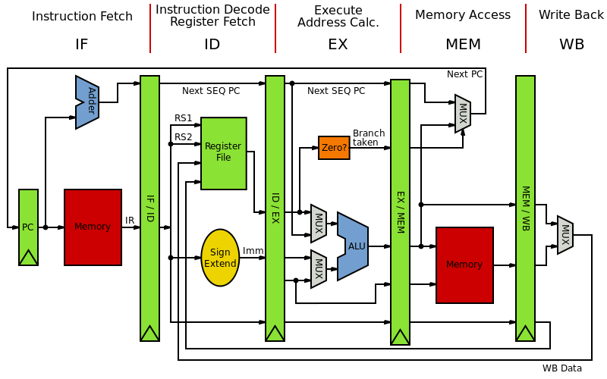

Slide 4
Typical machine execution
Typical fetch cycle: (M(x) means contents of x)
1. M(IC) → MAR [Memory Address register]
2. IC +1 → IC [Instruction Counter]
3. Read memory into MDR [Memory Data Register]
4. MDR → IR [Instruction Register for decoding]
Typical execute cycle: (OP R,X, DISP is instruction)
1. IR decoded into OP R, EA
  OP is operation code (e.g., 8 bits)
  R is register (e.g., 4 bits -- 16 registers)
  EA is effective address (e.g., 20 bits)
2. M(X)+DISP → MAR (EA → MAR)
3. Read memory into MDR
4. M(R) → ALU; M(MDR) → ALU
5. Do operation OP in ALU; ALU → R
For 500 MHZ: Each instruction 9-10 cycles (50 MIPS)
By overlapping fetch and execute cycles, get 60-70 MIPS

Slide 5
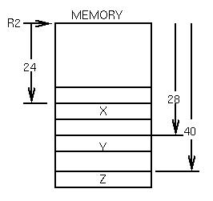
Typical machine translation
For example in C: As we see later, memory for data in blocks of storage pointed to by a register:
X = Y + Z
could be translated as:
load R1, R2, 28 [Location of Y]
add R1, R2, 40 [Location of Z]
store R1, R2, 24 [Location of X]
Instruction format:
Opcode register, index, offset
load R1, R2, 24

Slide 6
Software architectures
Previously
Build program to use hardware efficiently.
Often use of machine language for efficiency.
Today
No longer write directly in machine language.
Use of layers of software.
Concept of virtual machines. Each layer is a machine that provides functions for the next layer.

Slide 7
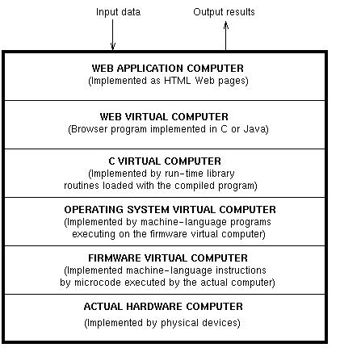
Virtual Machines
Example: Web application

Slide 8
Binding and Binding Time
Binding : program element에 속성 또는 수행에 필요한 요소를 연결하는 것
예 :: 변수 → 형(type), 기억장소 (memory) , 값, …
Binding time : Binding이 일어나는 시간
  Execution time (run time) :: 기억장소나 값
    On entry to a subprogram or block :: C, C++의 형식인자와 실질인자의 연결
    At arbitrary points during execution ::: LISP, SMALLTALK, ML, Java
  Translation time
    Bindings chosen by the programmer ::: 변수이름, 형,
    Bindings chosen by the translator ::: C의 integer 크기, memory class에 따른 기억위치, array의 저장방법 ???
    Bindings chosen by the loader (linker) ::: external 변수의 참조

Slide 9
Binding time (Cont.)
Language Implementation time
  One’s complement ? 2’s complement
  연산자의 구현 방법, ….
Language Definition time
  Data structure types, statement forms, ..
예 ::: X=X+10
  X의 형
    translation time ➔C, C++, Java, Ada
    Run time ➔ LISP, SMALLTALK, PERL
  X에 넣을 수 있는 값의 집합
  X의 값
  10의 표현 … 언어정의 시 (10→ 정수, ’10’), 언어구현 시 (10의 표현)
  ‘+’의 의미
    ‘+’ → addition(언어정의 시), overload 해결 (compile 시), 더하기가 구현되는 방법 (implementation time), 실제연산 (execution time)

Slide 10
Binding time and languages
C, C++, Ada, FORTRAN
← translation time binding (early binding)
LISP, ML, Perl, HTML
←runtime binding (late binding)
Binding and scope rule

Slide 11
최근 경향
CISC -> RISC -> CISC (Pentium으로 CPU는 통일???)
Multi-core microprocessor : dual-core, twin core
  Chip-level multiprocessing
  Thread-level parallelism
  법률적 문제!!!!
분산처리, Multi-processing
P2P
Grid Computing
Global network 환경에서 거대한 Grid에 기반한 분산 처리
  Sensor network
  Random, Small World, Scalable network
Service-oriented architecture
Event-driven approach
JINI of SUN, .Net of Microsoft
High-parallel processing
GPU를 이용한 대용량 정보처리: 인공지능(기계학습), big-data 처리

